Slide 1
Traineeship 2023 – Powershell

Slide 2

Xavier Clinquart
Who am i?
Xavier.clinquart@axxes.com
Working with Axxes since December 2014
Senior system everything @ Groven +
In love with Automation
Proud member of the Axxes Powershell PACMAN Club

Slide 3

Dieter De Smet
Who am i?
Dieter.desmet@axxes.com
Working with Axxes since October 2018
Senior system engineer @ Argenta Private Cloud Team
In love with Automation and Home Automation
Proud member of the Axxes Powershell PACMAN Club

Slide 5

Contents
Choose your tools
Finding information and help
Understanding commands
The Pipeline
Actual scripting
Error handling
Logging
Modules
Active Directory Module
Notes:
HELP, ERROR, Understanding commands, LOGGING – Dieter
Tools, Pipeline, Actual, Modules,AD - Xavier

Slide 6
Choose your tools
Command line , Windows Terminal
PowerShell ISE
Visual Studio Code
Other IDE’s (Visual studio , notepad++, …)

Slide 7
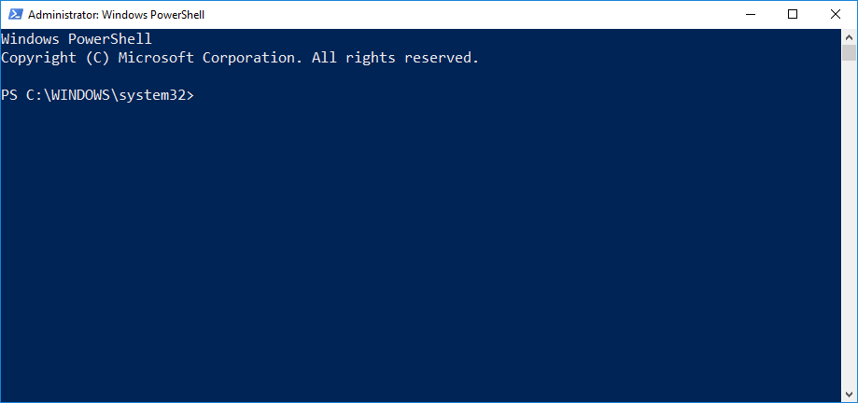
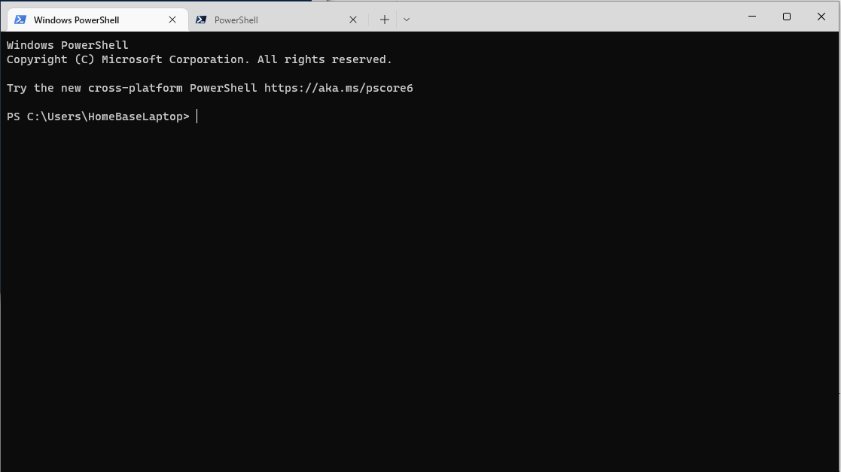
Command line shell
Excellent for quick commands
Limited in tab completion
Not OK for scripting
Terminal : Easy access to different versions

Slide 8
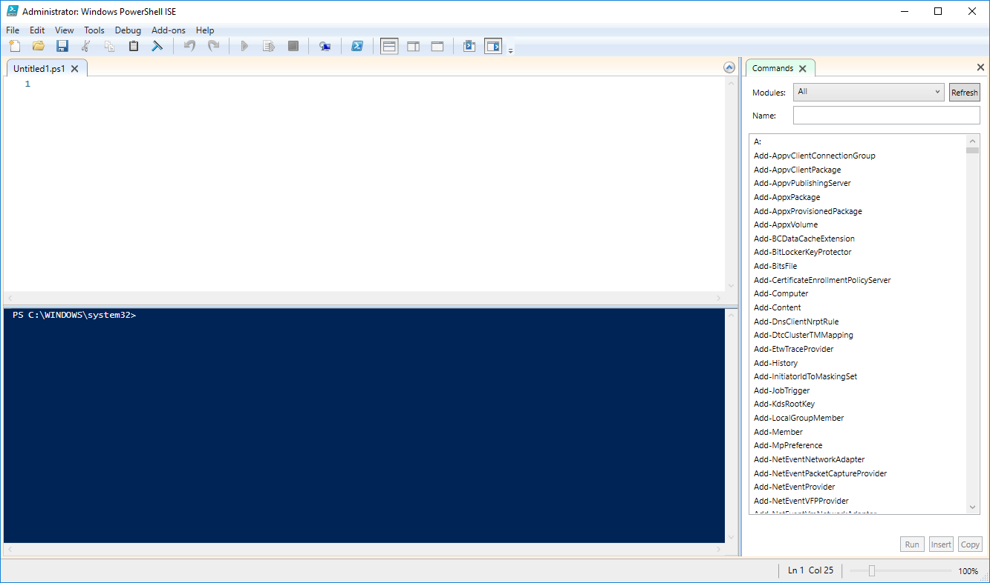
PowerShell ISE
No longer developed by Microsoft
IntelliSense + Tab completion
Debug functions
Add-ons
Good for scripting
Still used by many Dev’s

Slide 9
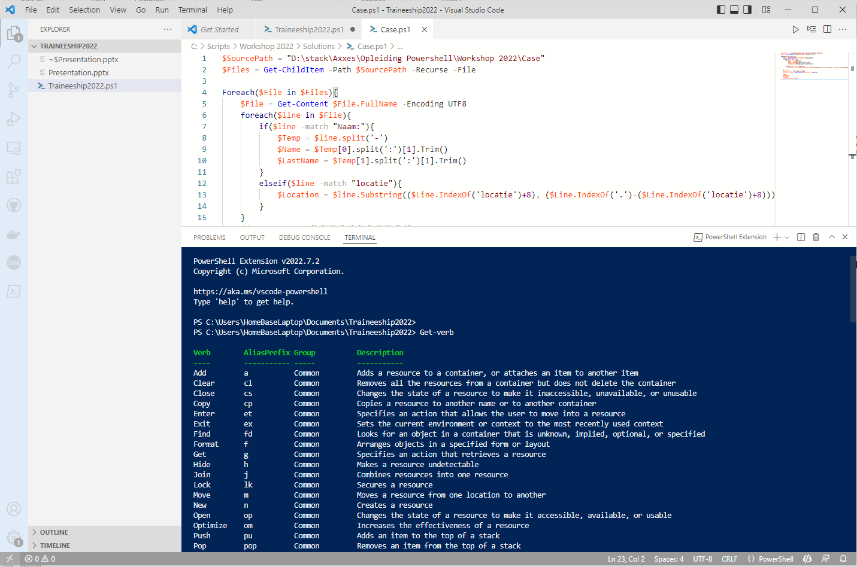
Visual Studio Code
Advised choice by Microsoft
Tons of Extensions
IntelliSense
GIT Support
Easy to manage bigger projects
Platform independent

Slide 10
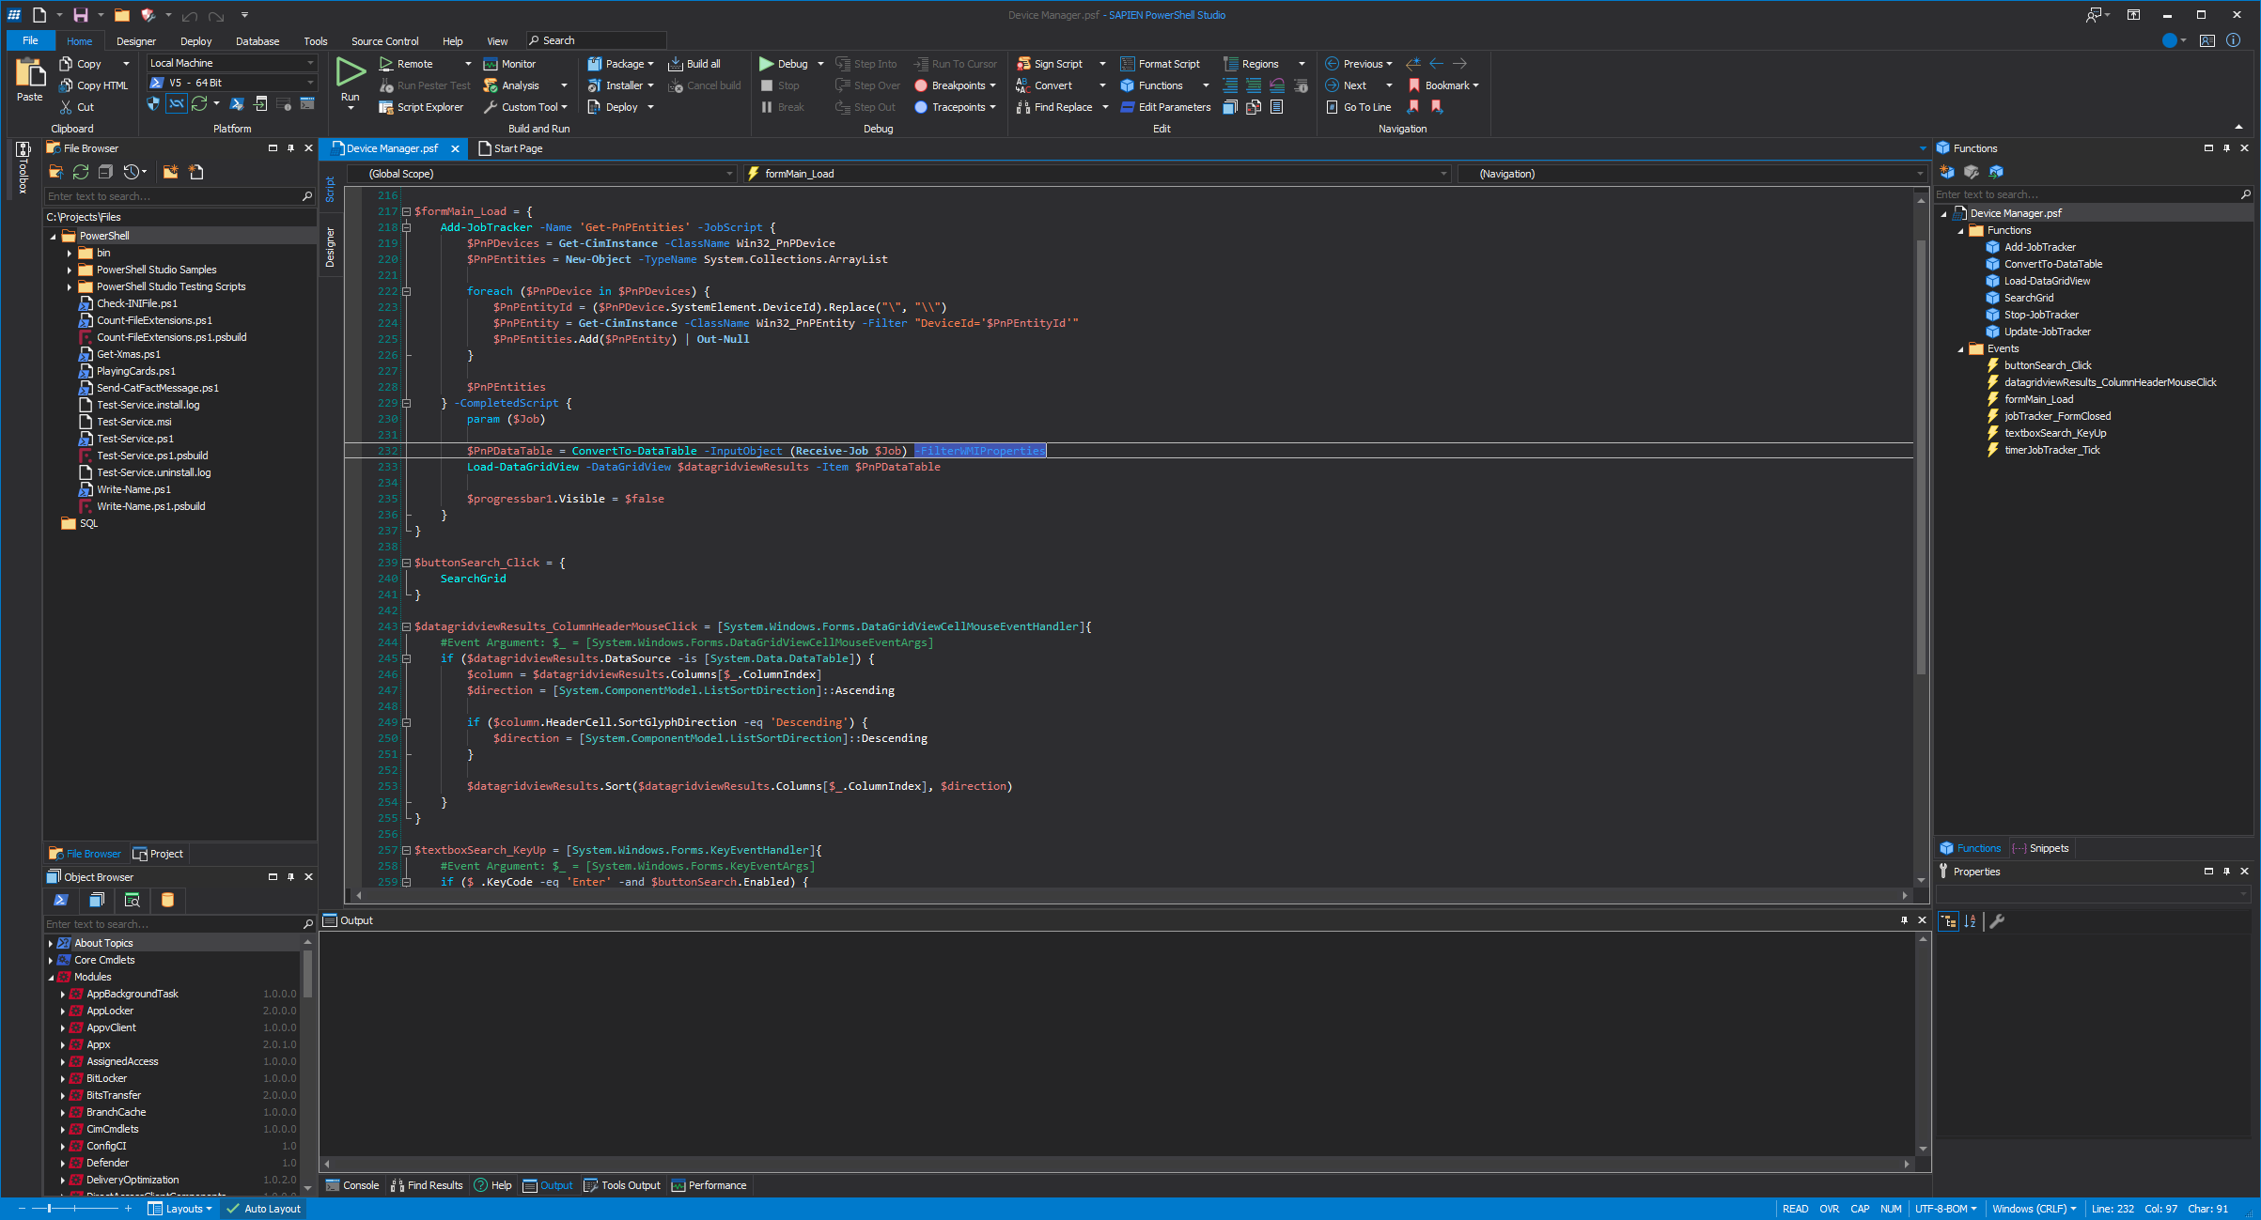
Other IDE’s
2 categories
Paying:
Visual Studio
Sapien PowerShell Studio 2023
Free
Notepad.
++
Notes:
https://www.sapien.com/software/powershell_studio

Slide 11

Lets hop over to some code

Slide 12
Finding information and Help

Slide 13
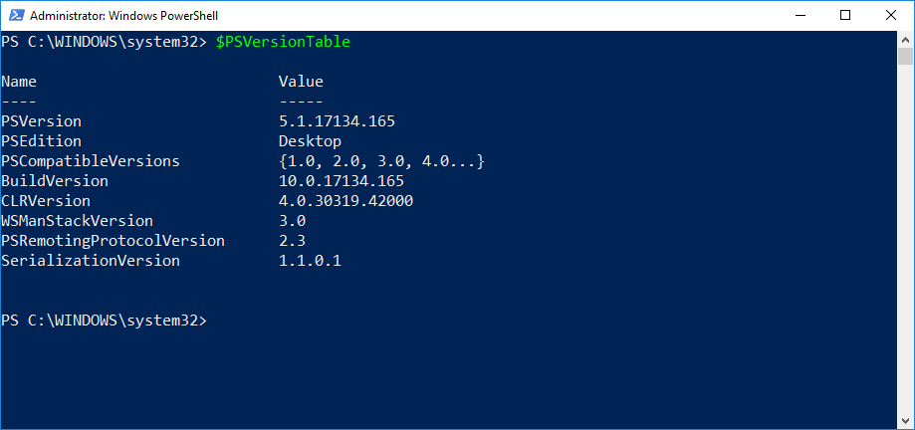
Tab Completion and Intellisense
Tab completion:
Type Get-S in the CMD and press TAB.
Type Dir C:\ and press TAB.
IntelliSense
Tab completion, but with a nice dropdown menu.
Finding your PSversion
$PSVersionTable
get-host | select-object version

Slide 14
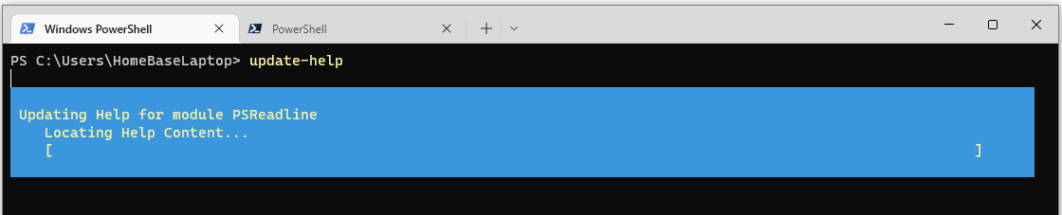
The Get-Help command
Built in help function
Requires update (run as admin)
Get-help

Slide 15
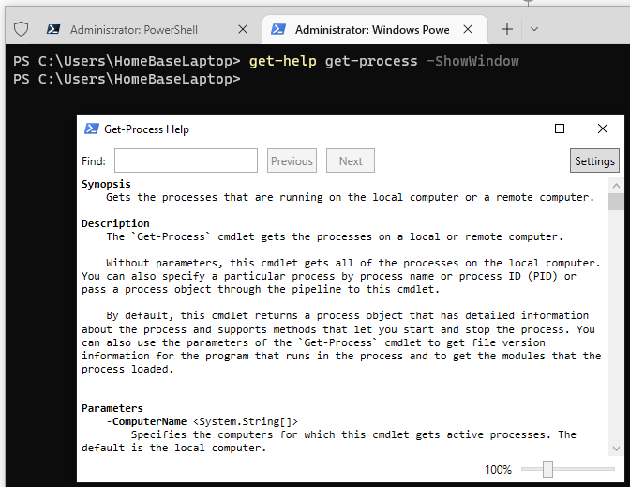
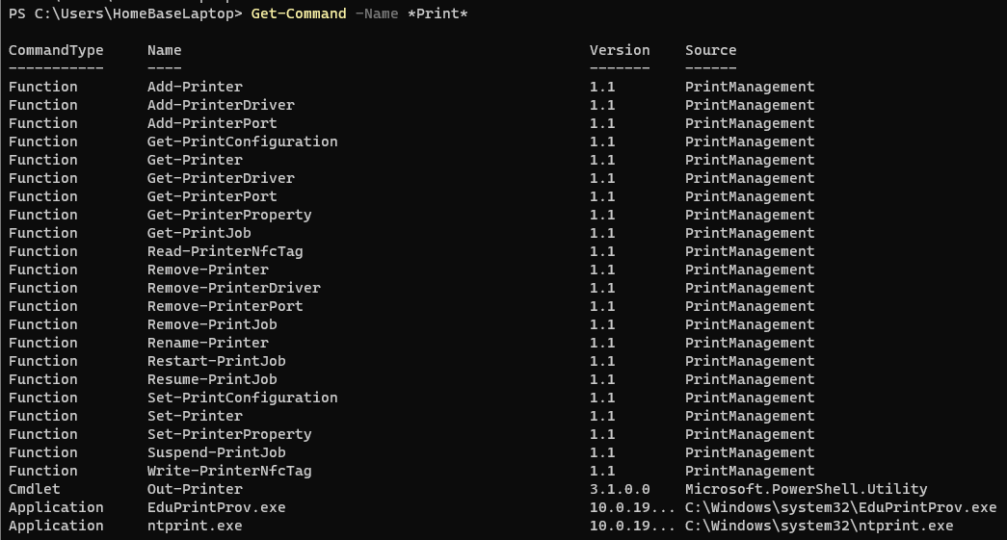
Find help for commands
Commands -> -showWindow
-Online , -Full , -Example
Get-command to find commands
Show-command

Slide 16
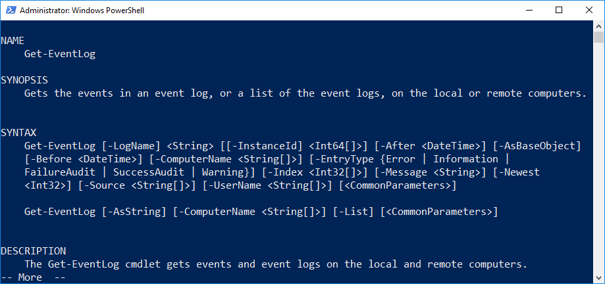
Interpreting Get-help output
Syntax
Multiple syntaxes, multiple parameter sets
Mutually exclusive
Optional parameters
Mandatory parameters
Positional parameters

Slide 17
Optional and Mandatory parameters
Optional parameter in square brackets.
[-ComputerName <String[]>]
Mandatory parameters not in square brackets.
[-LogName] <String>
Will be prompted for if you do not specify.

Slide 18
Positional Parameters
Commonly used parameters.
Not required to type them out.
Example: [-LogName] <String> [[-InstanceID] <Int64[]>]
-LogName is not optional, no square brackets surrounding both name and value.
-LogName is surrounded by square brackets, making it positional.
-InstanceID is optional, both name and value surrounded by square brackets.
-InstanceID is positional, because it is surrounded by square brackets.

Slide 19
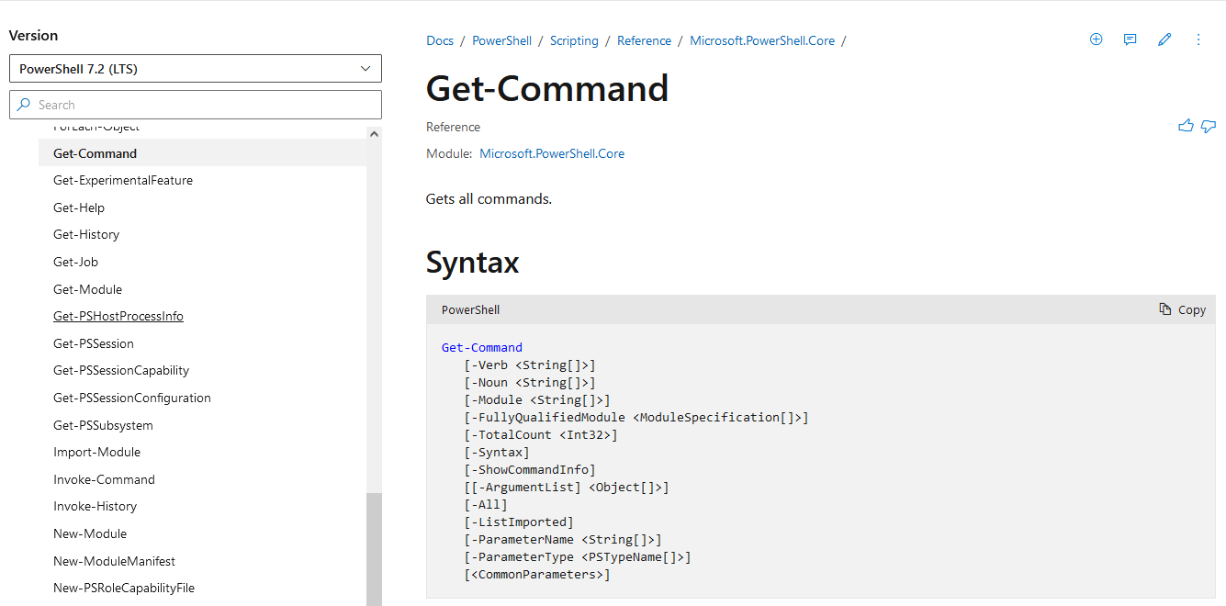
Online Help
Microsoft Docs
Google , Bing , DuckDuckGo , …
https://github.com/PowerShell

Slide 20
Labo

Slide 21
Understanding commands

Slide 22
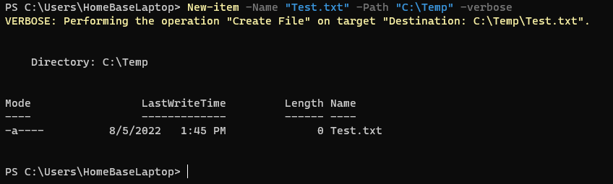
The anatomy of a command
Command
Name: New-item
Parameter 1
Name: -Name
Value: “Test.txt”
Parameter 2
Name: -Path
Values: “C:\Temp”
Parameter 3
Switch parameter
Name: -verbose , -whatif

Slide 23
Aliases
Alias: short nickname
“gsv” instead of “Get-Service”.
Get-Alias
Get-Alias –Definition Get-Services
New-Alias
Not advised for sharing

Slide 24
Wildcards
Most of the “item” cmdlets include the –Path property.
* -> a*
? -> ?n
[ ] -> [a-e]calc or [alz]calc
Wildcards are allowed here.
Example: Get-item –Path C:\*.exe
Cancel out Wildcard
`* -> `?

Slide 25
Output of commands
Direct variable
Object
Get-Member

Slide 26
The Pipeline

Slide 27
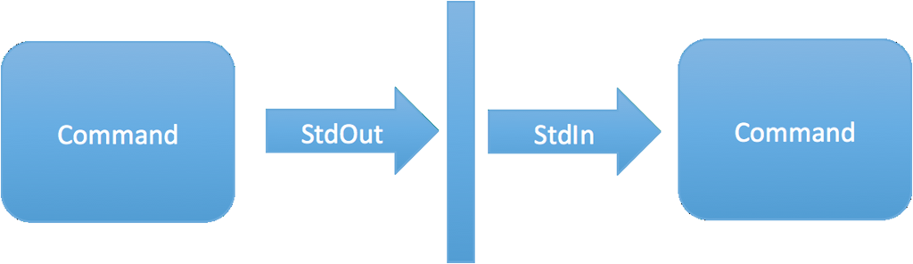
The Pipeline
Use output as input
Not on all commands
Sorting , Filtering
Looping

Slide 28
Some Code

Slide 29
Actual Scripting

Slide 30

Variables

Slide 31
Statements
If else elseif
Switch case
While
Do while
Foreach
For

Slide 32
Logical Operators
-eq
-ne
-ge
-le
-lt
-gt
-AND
-OR
-NOT , !
++ , --

Slide 33
Input and output
Read-host
Write-host
Out-default
Write-Output
Get-Content
Out-file
Clear-host

Slide 34
Functions
Definition
Parameters
Return value

Slide 35
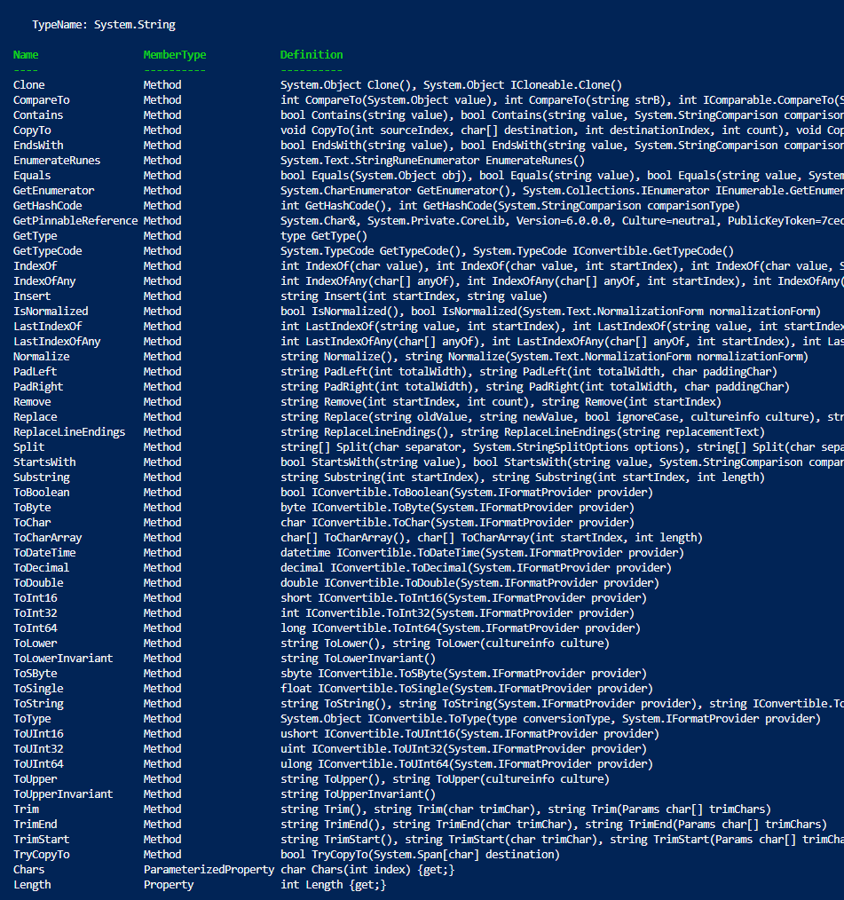
Text manipulations
Conversions
Replace
Splitting
Removing
Trimming
Substrings
Searching/compairing

Slide 36
Labo

Slide 37
Error handling

Slide 38
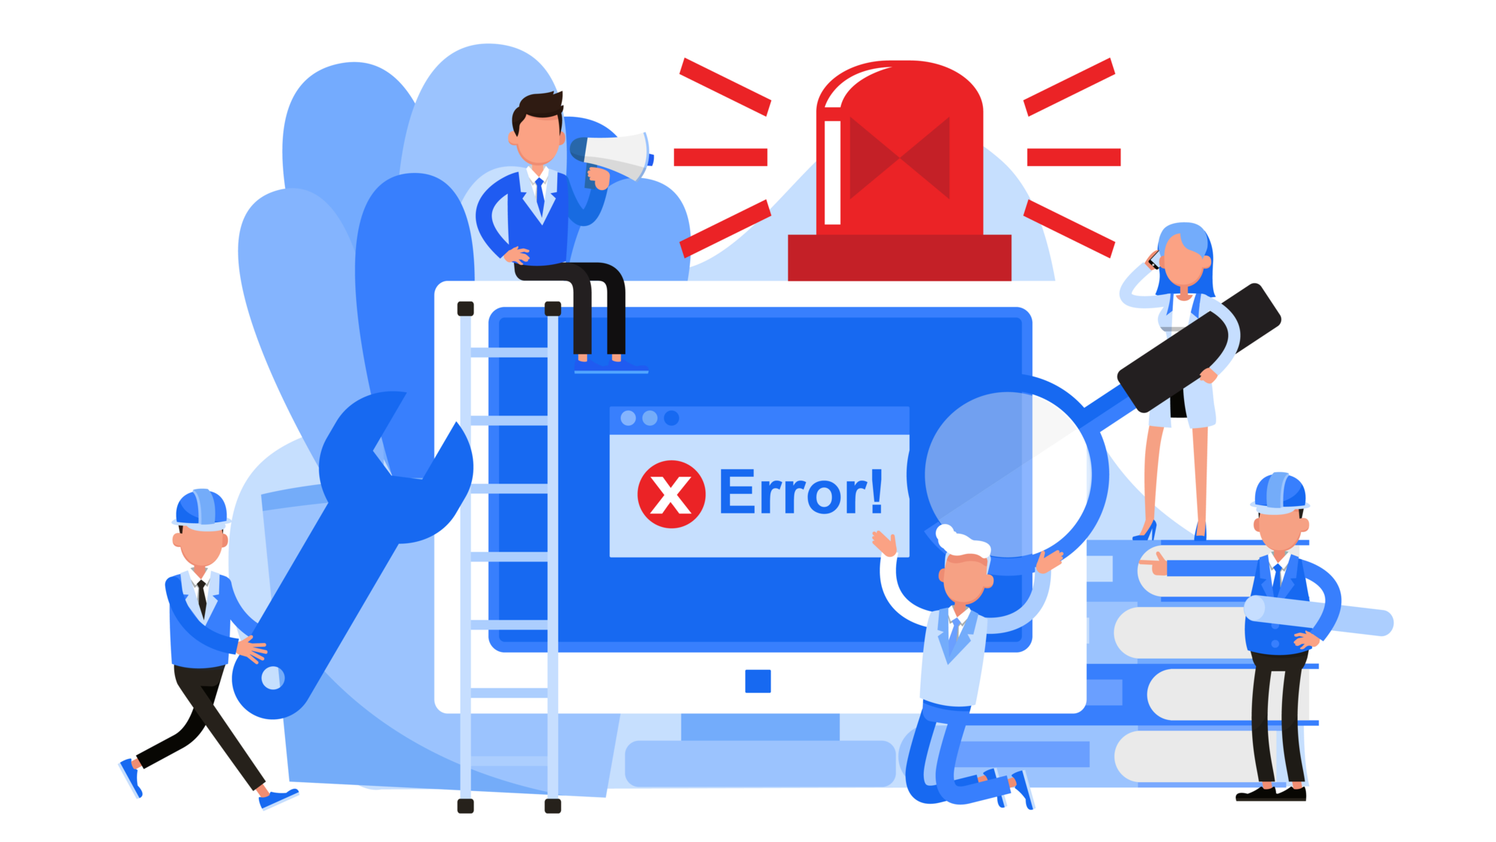
Error handling
Try , catch , Finally
Filtering on exceptions
Triggering contingency’s
Exception list

Slide 39
Lets hop over to some code

Slide 40
Logging

Slide 41

Logging
Data
Outcome
Out-file
PsTranscript

Slide 42
Inline Logging/debugging
6 Streams
Success stream
Error stream
Warning stream
Verbose stream
Debug stream
Information stream
(Progress stream)

Slide 43
Lets hop over to some code

Slide 44
Modules

Slide 45

Modules getting started
What
Why
How to get
How to create

Slide 46
Lets hop over to some code

Slide 47
Active Directory Module

Slide 48
What can you manage
Users
Groups
Computer objects
OU’s
Trusts
…

Slide 49
Why would you use it
Repeatable
No human error
Execute mass change in one go

Slide 50
Reporting
Create output based on filters
Any attribute
Good filtering = Win in Time/Performance
Filter as soon as possible

Slide 51


Questions + Use Case (If we have time ! Or if you really really really want to)

